Slide 1
Sprint 2 -Team 4 Text Mining System requirements gathering
Ahmed Ashraf Sadek, Amanda Long, Zawaad Shah

Slide 2
Sprint Stories
MS SQL Server
Power BI Connection & Initial DA
Proposed ERD & Data Assumptions
Anaconda (Python) initial
Spacy Setup and Pilot

Slide 3
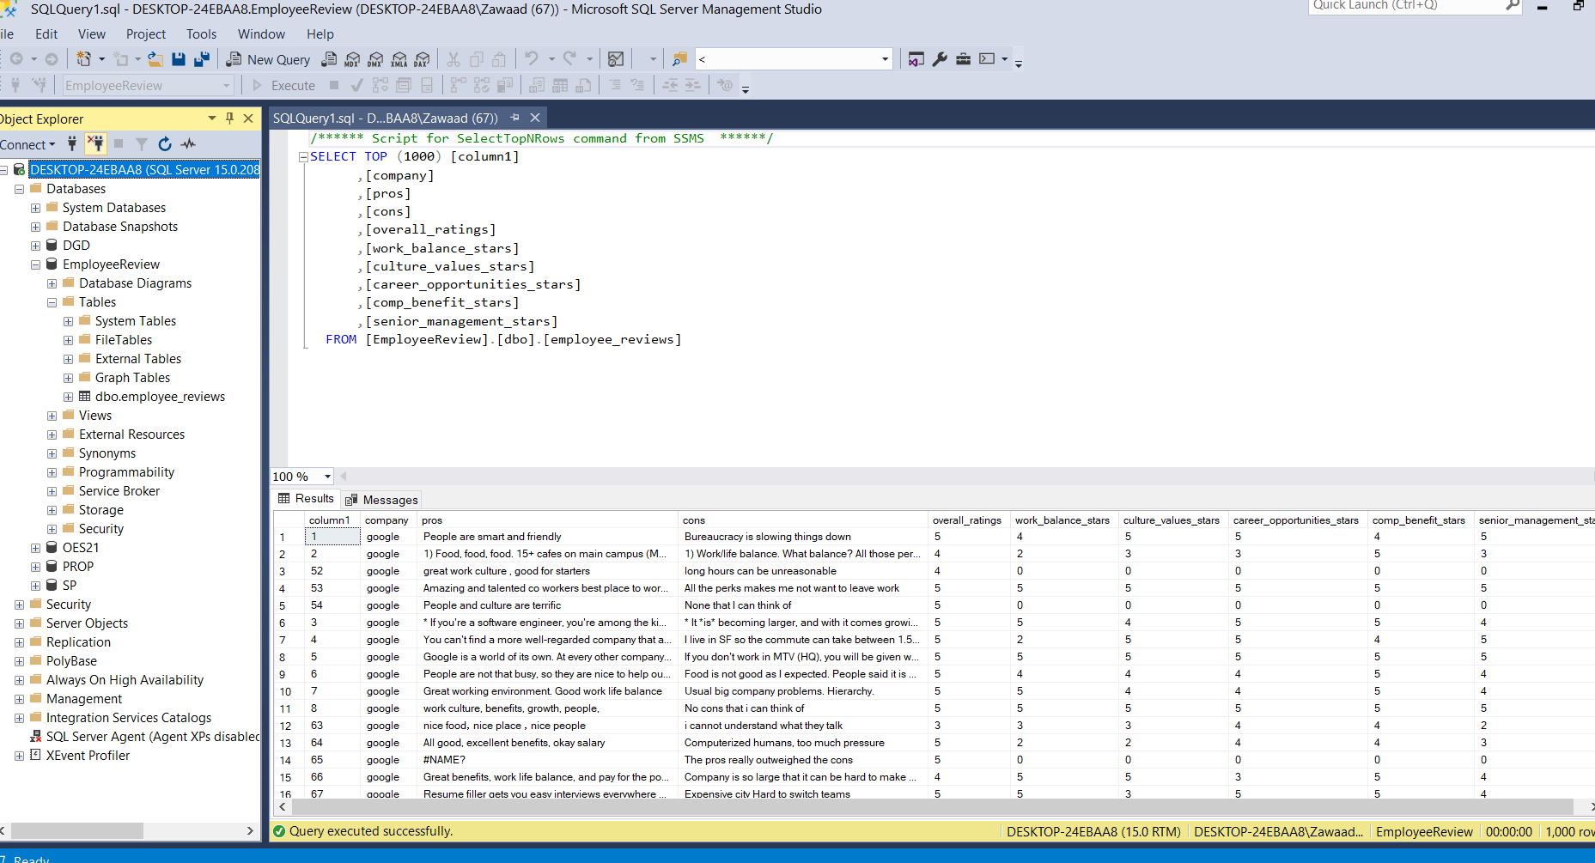
1. SQL Server setup

Slide 4
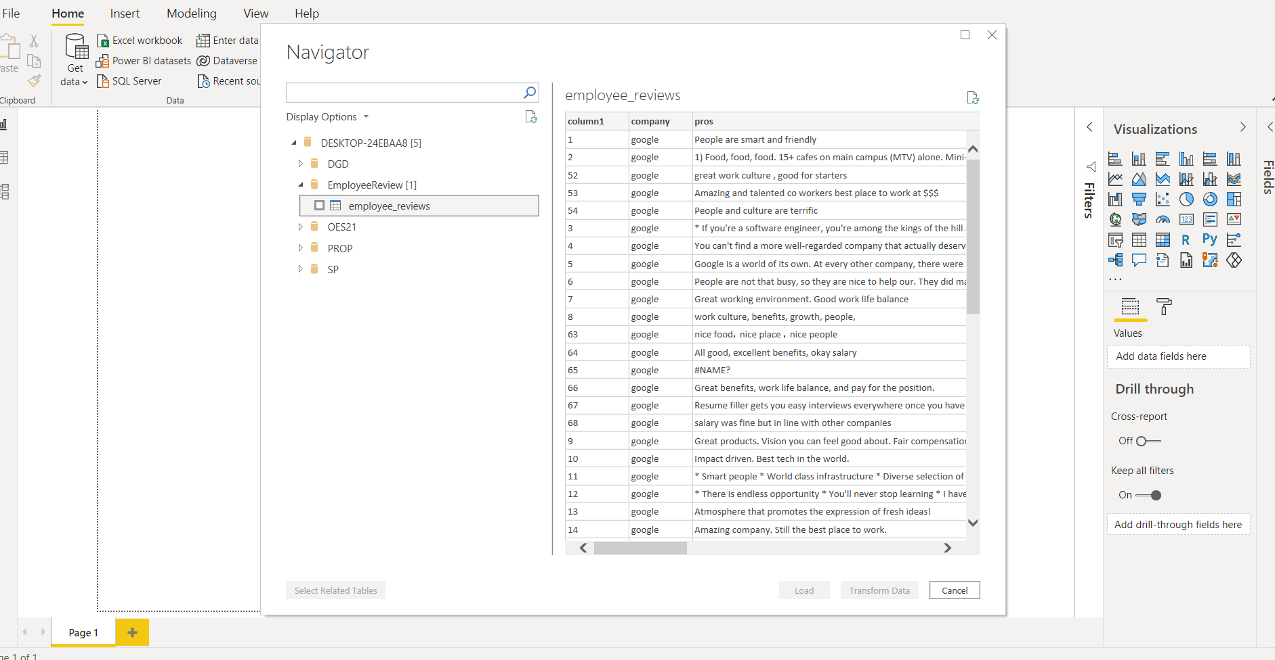
2. Connect to POWER BI

Slide 5
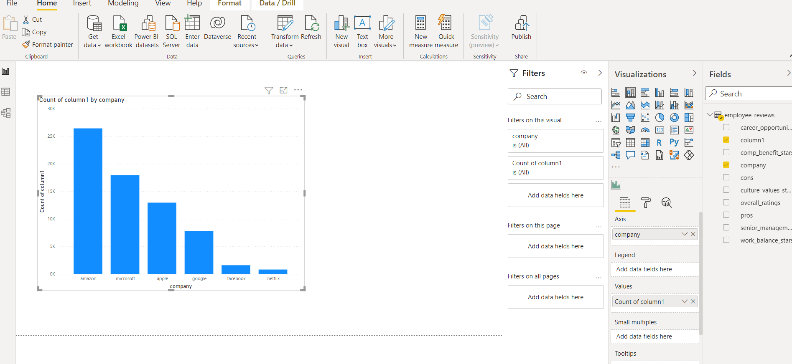
Power Bi initial Analysis

Slide 6
Proposed Visualization ideas
Word Cloud
Sentiment Analysis
Scatter Plot
Heat Map

Slide 7
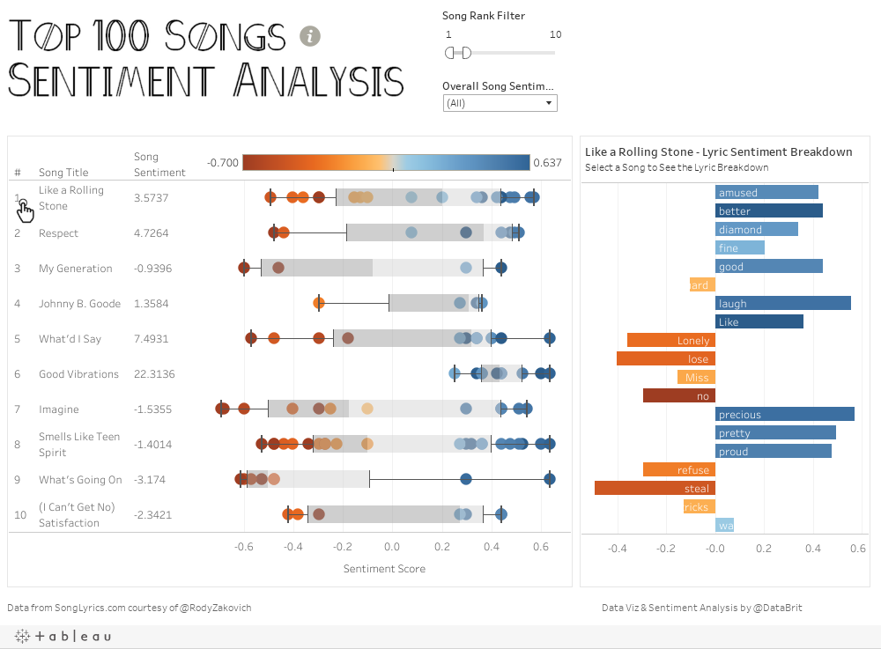

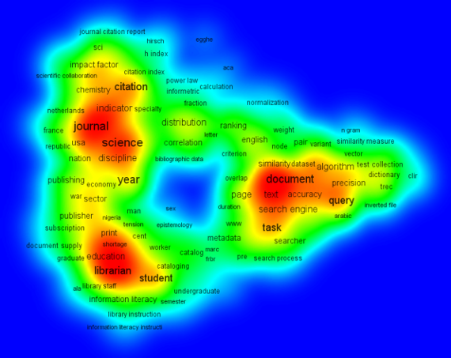
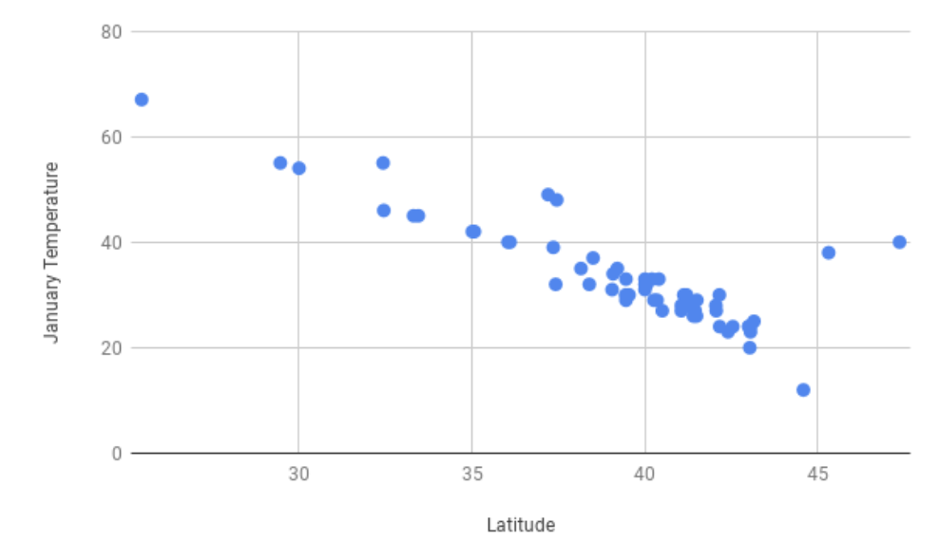
Word Cloud
Sentiment analysis
Heat Map
Scatterplot

Slide 8
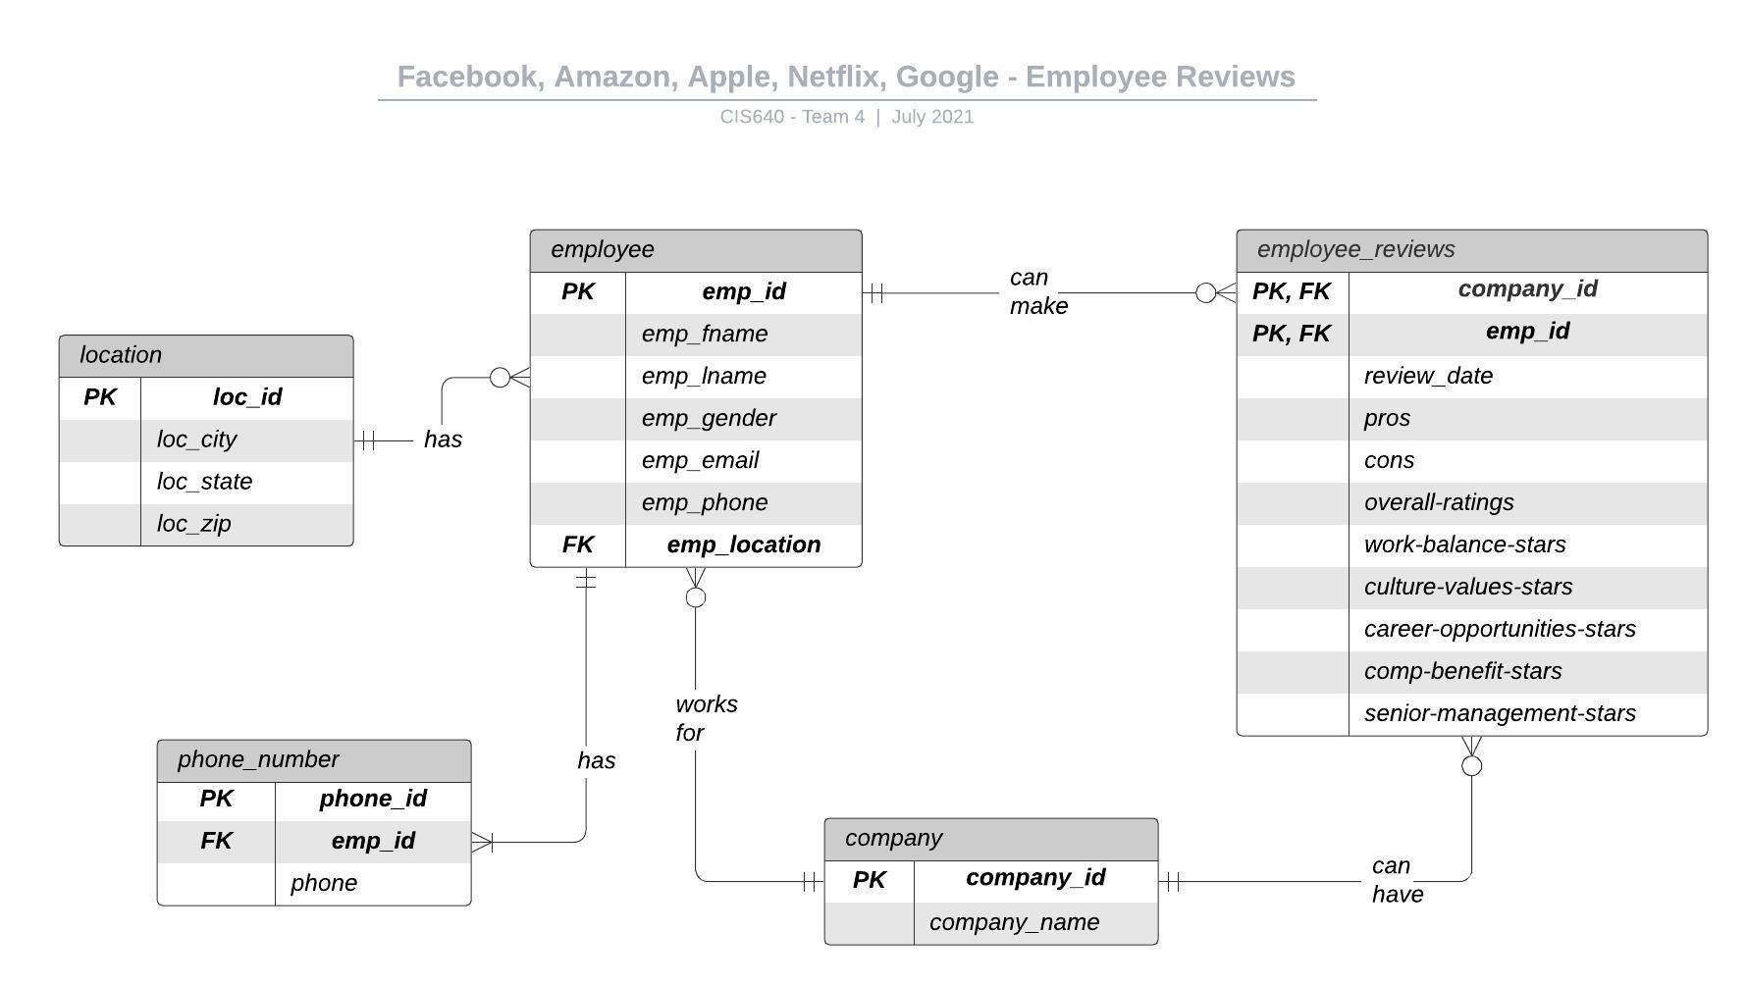
3. Proposed entity relationship diagram

Slide 9
Data assumptions
Each employee belongs to only one company.
Each company can have multiple employees.
Each review belongs to exactly one employee/company combination
Reviews start from 2019 and continue up to the current moment in time.

Slide 10
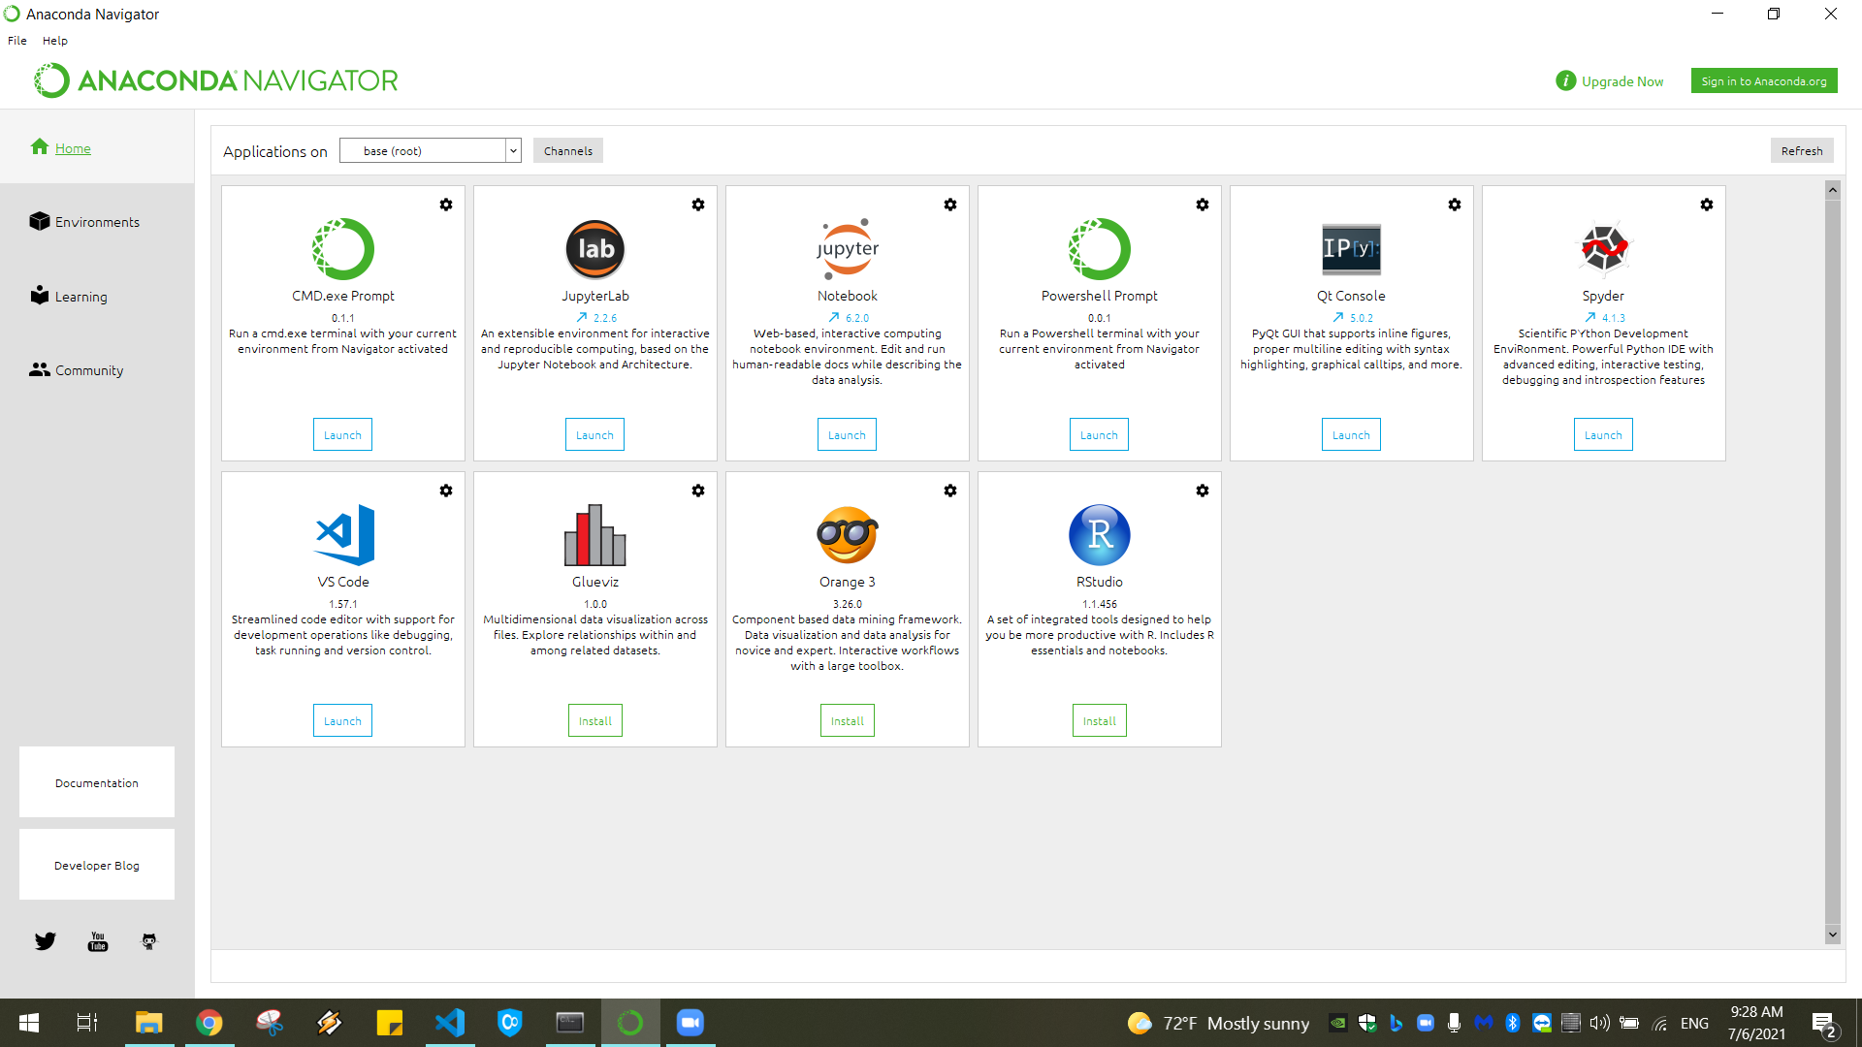
4. Python & Anaconda

Slide 11
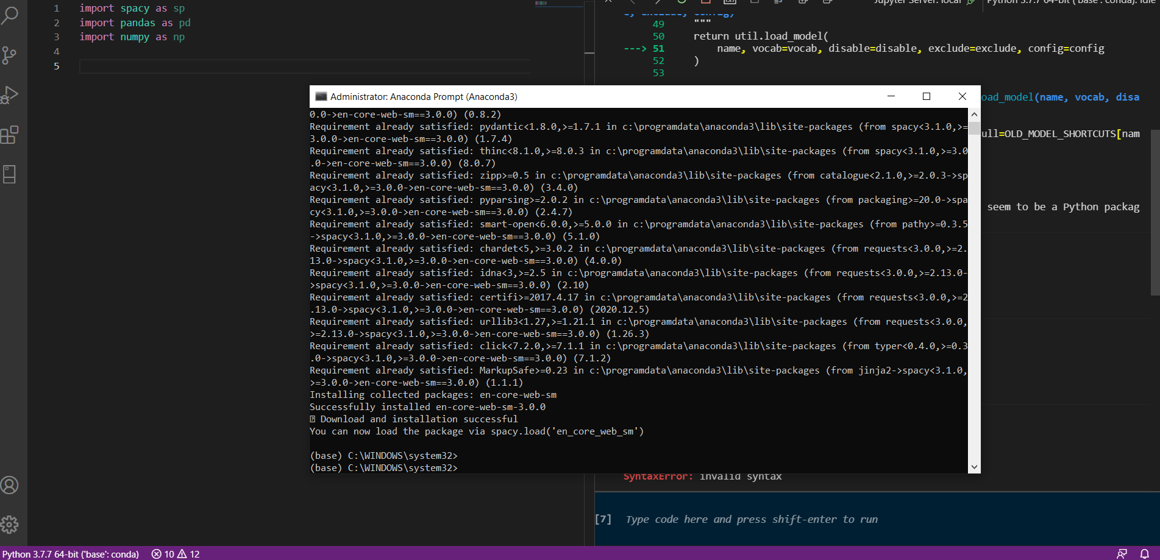
Spacy in python

Slide 12
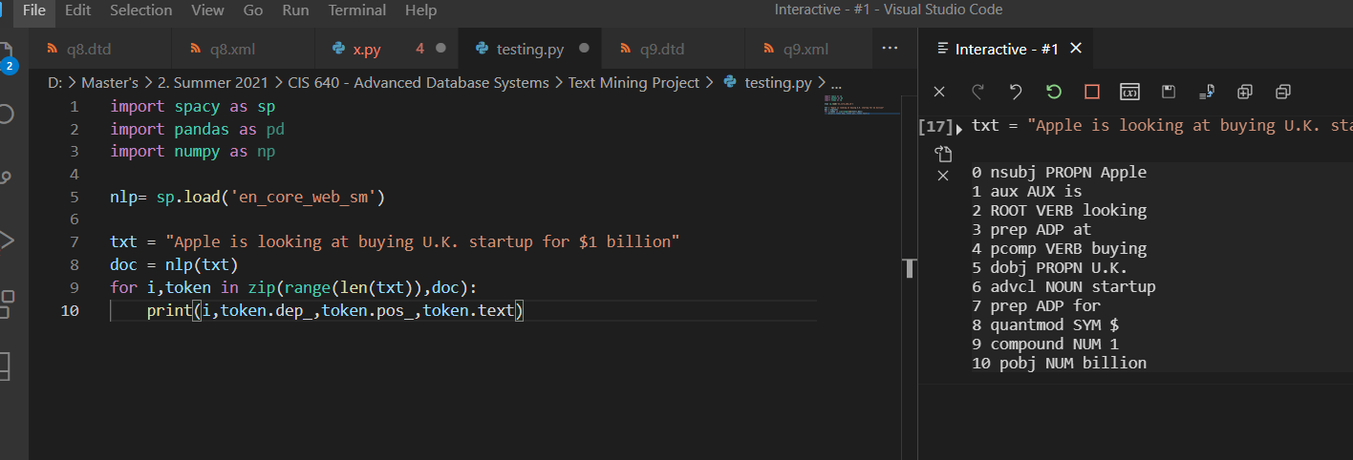
5. Spacy initial test
Universal Part of Speech (POS) Tags

Slide 13
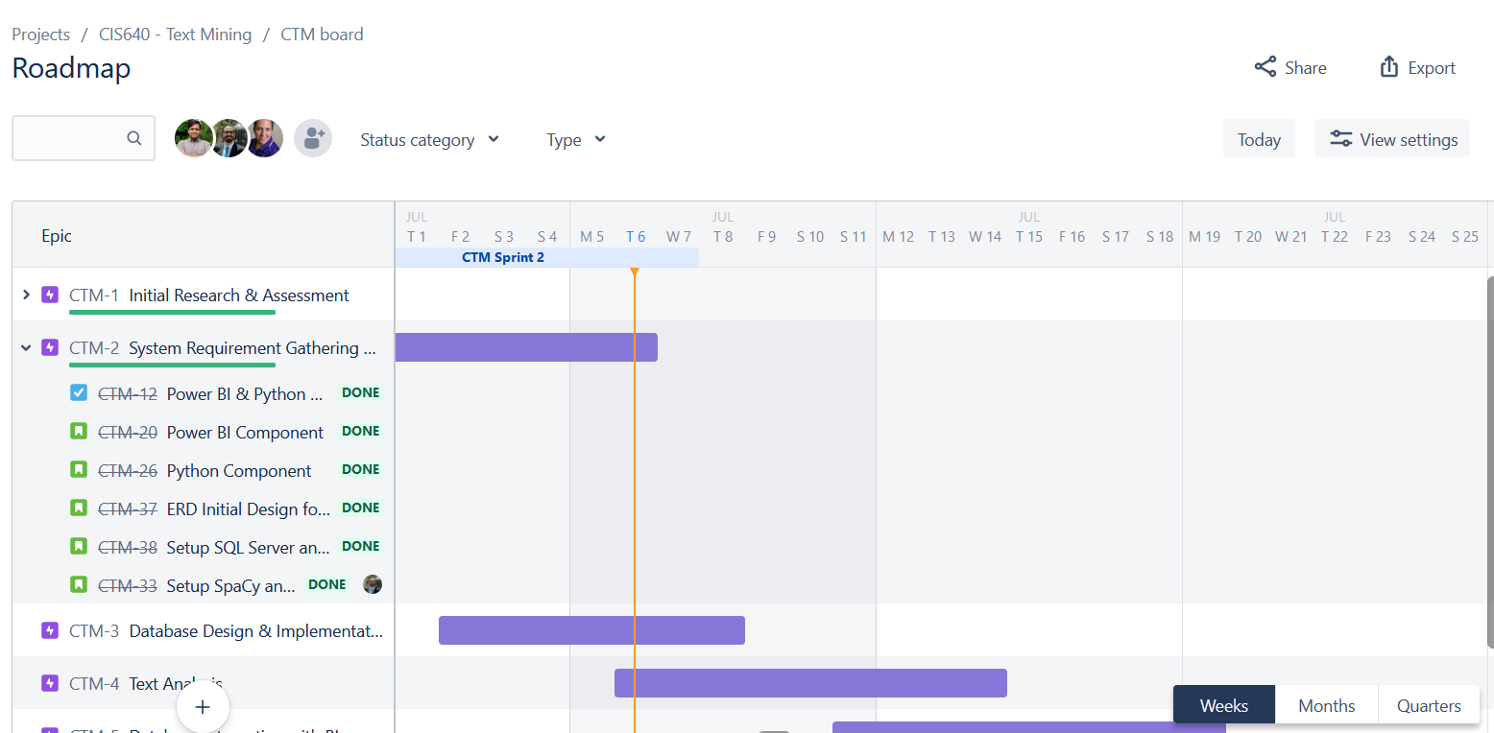
Sprint 2 – Done

Slide 14
Next Sprint – Proposed Tasks
Updated Database Design and Implementation
Enforcing Data Governance Rules & Constraints
Connection to Python from MS SQL Server to pull and push the data.
Text Mining with SpaCy and creating visualizations with Pandas.
Creating visualizations in Power BI through data exported from Python.

Slide 15
Thank you ☺

